Slide 1

Drug product recall
Presented By:
Deepa
TP Team.

Slide 2
Product Recall
A Product Recall is a request to return to the maker, a batch or an entire production run of a product, usually over safety concerns or design defects or labelling errors.
Reasons of Recall:
Detection of quality and safety failure after release.
Result from the ongoing stability testing.
Results of an Inspection- Label mix up, leaking of Product, etc.
Ex: Vioxx (Rofecoxib) introduced by Merck in 1999, recall from the market on September 30, 2024.
Reason found to increase the risk of cardiovascular disease.

Slide 3
FDA Classification of Drug Recalls:
Class I: | Class II: | Class III:
A dangerous or defective product that could cause serious health problems or death. Example: a label mix-up on a lifesaving drug. | A product that might cause a temporary health problem. Example: a drug that is under-strength but is not used to treat life-threatening situations. | Minor defect or other condition that would not harm patient, but drugs cannot be resold.

Slide 4
List of Agencies for Different Countries
Country | Regulatory Body | Guidelines under
USA | Food & Drug Administration | 21 CFR Parts, 7, 107 and 1270.
India | Central dug Standard Control Organization (CDSCO) | Para 27, 28 of Schedule M and conditions of license for defective product recall in Rule74(j) and rule 78(i) of the Drugs and Cosmetic Act, 1940 and Rules there under.
UK | Medicines and Health care products Regulatory Agency (MHRA) | Scetions 2(2), 4, 5 and 7 of the European Communities Act 1972 and Directive 2001/95/EC on general product safety.
South Africa | Medicine Control Council | Section 19(1) of the Medicines and Related Substances Act, Act 101 of 1965 and Regulation 43(1) of the Medicines and Related Substances Control Act, Act 101 of 1965.
Australia | Therapeutic Goods and administration (TGA) | Section 65F of the Trade Practices Act 1974.

Slide 5

Recall Initiation:
FDA Requested Recalls:
FDA may request that Exela Pharma Sciences to initiate a recall. FDA will send Notification through Letter or Telegram Notification contains Violation, Recall instructions to conduct recall. Based on the Instructions Exela will follow the Recall Procedure.
Exela Pharma Sciences- Initiated Recall:
Exela Pharma Sciences may voluntarily initiate a recall at any time.

Slide 6
Product Recall in following steps:
Create Your Notice: Enter the details of Recall product Data, Enter Recall Instruction Workflow, Individual target Recipients
01
Send Notice:
Issue Notice to Customers, Automatically Notify Regulators and Government Agencies, Mobile Friendly Platform
02
Receiver Response: Recipient Action Notice, Products Quarantined, Recipients Communicate product Recovery.
03
Close off: Complete Regulatory Process and Requirements. Finalise internal reporting and Auditing, Maintain Recall Ready/live status.

Slide 7
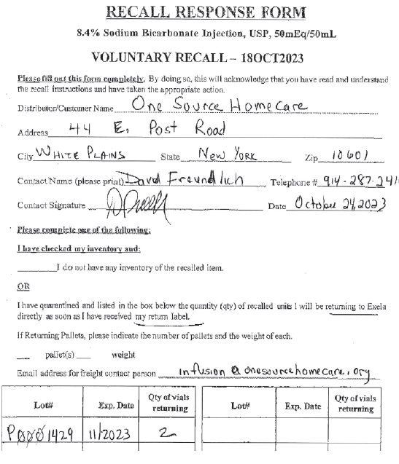
Example of a Product Recall Form

Slide 8
Exela Pharma Recalls in 2023
Exela, based in Lenoir, North Carolina, is a specialty pharmaceutical company focused on developing and manufacturing generic and name-brand sterile injectable products.
Exela is working with FDA to recall 3 separate medications- Sodium Bicarbonate for metabolic Acidosis, midazolam for sedation, and the L-Cysteine for Nutrition Additive- after inspections of left over samples flagged silicone matter in some vials.
Injecting drugs contaminated with particulates can cause injection site irritation or swelling. If the particulate matter reaches the blood vessels, it could travel to various organs and block blood vessels in the heart, lungs or brain. That could cause stroke or even death. For this reason, Exela is recalling the 3 types of products.
Exela is recalling eight batches of Sodium Bicarbonate, going to expire between November 2023 and December 2024.
For other two drugs, Exela is pulling single lot each of Midazolam and Elcys, which were set to expire in July 2024 and March 2025.

Slide 9

Recall Product Return Processing
Upon completion of return processing, the returned recall product will be rejected and placed in the Max Reject Cage.
Upon receipt of the Final product return, and approval from the FDA, the recall Coordinator and Facilitate Management, or approved supplier, to facilitate the destruction of returned recall product.

Slide 10

Thank you

